Slide 1
IT’S TIME
FOR THE
TOWN HALL!

Slide 2
Text your question or issue to 480.748.5764

Slide 3
Exchanging Reports
For jurisdictions with full participation in the Clearinghouse, we will be uploading data on licensee demographics , transmittal data and summary transmittal data to the Clearinghouse.
We have also received other reports, for example, IFTA added accounts reports and other reports, from other jurisdictions on a periodic basis.
We are wondering if the information is already uploaded on the Clearinghouse, do we still need to exchange such reports?

Slide 4
Anomaly
We recently uncovered a situation that appears to be an anomaly, where the customer can’t seem to qualify for IFTA in either Jurisdiction A (where he actually resides and has a business) and Jurisdiction B (where he keeps certain vehicles that engage in local operations and never cross state lines out of Jurisdiction B).

Slide 5
Anomaly
Background: Customer is a Jurisdiction A resident who purchases buses in Jurisdiction B and retrofits them to haul watermelons from farms in Jurisdiction B to markets within Jurisdiction B. The customer purchases straight plates in Jurisdiction A for these buses.
Customer anticipates running 12 buses. These buses never leave Jurisdiction B; at the end of the season the buses are winterized and parked until the next season.

Slide 6
Anomaly
The customer is being told by DOT in Jurisdiction B that he needs either IRP or IFTA permits to operate these buses! He does not qualify for either IRP or IFTA since there is no travel outside of Jurisdiction B!

Slide 7
Anomaly
The customer is being told by DOT in Jurisdiction B that he needs either IRP or IFTA or permits to operate these buses. Jurisdiction A is of the opinion that he does not qualify for either IRP or IFTA since there is no travel outside of Jurisdiction A.

Slide 8
Anomaly
Question; Are there any exemptions for buses used for this purpose or does this customer qualify for Covered Farm Vehicle and if so, do jurisdictions recognize Covered Farm Vehicles under the federal guidelines?
Have other jurisdictions encountered this situation and how did they handle it?

Slide 9
R510 RENTAL/LEASING
.200 Long-Term Leases.
A lessor regularly engaged in the business of leasing or renting motor vehicles without drivers for compensation to licensees or other lessees may be deemed to be the licensee, and such lessor may be issued a license if an application has been properly filed and approved by the base jurisdiction

Slide 10
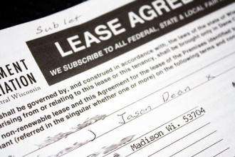
Long Term Leases – R500
Smith Leasing is based in US Jurisdiction A
They own trucks and they lease 2 of their trucks, without drivers, to two CAN Jurisdiction B customers under long term leases.
Smith Leasing supplies the IFTA credentials under a CAN Jurisdiction C IFTA account and reports all of the fuel and miles for the two CAN Jurisdiction B customers.

Slide 11
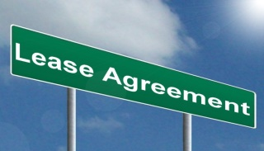
Long Term Leases – R500
Smith Leasing had some communication with CAN Jurisdiction B which resulted in CAN Jurisdiction B asking the two Smith Leasing customers to have their own IFTA accounts.
The IFTA Attorneys Section was consulted and the answer was that the language is not clear.

Slide 12
Long Term Leases – R500
The two Smith Leasing customers do not work for Smith Leasing and they use the trucks for their own purposes.
Smith Leasing will have a problem because the two accounts cannot be under Smith’s consolidated IFTA account.

Slide 13
Long Term Leases – R500
Do the two CAN Jurisdiction B customers need to have their own IFTA accounts even if the trucks are owned by Smith Leasing?
Does the rule change if with or without drivers?

Slide 14
Tax Rate Matrix
Can a footnote flag be added to the files that are downloaded for the tax rates?
Currently this data is indicated by text starting with #xx. They are not suggesting that be changed, but simply add a column in the spreadsheet that would be Footnote – “Yes” or “No”. This would be for tax rate downloads files going forward

Slide 15
Tax Rate Matrix
Justification:
It would greatly reduce the manual work needed for a jurisdiction that creates their own tax rate matrix by allowing the footnote indicator to be downloaded versus manually keyed. I’m not sure how many jurisdictions create their own tax rate forms or just have taxpayers view it on IFTA Inc.’s website. We publish our own tax rate matrix.

Slide 16
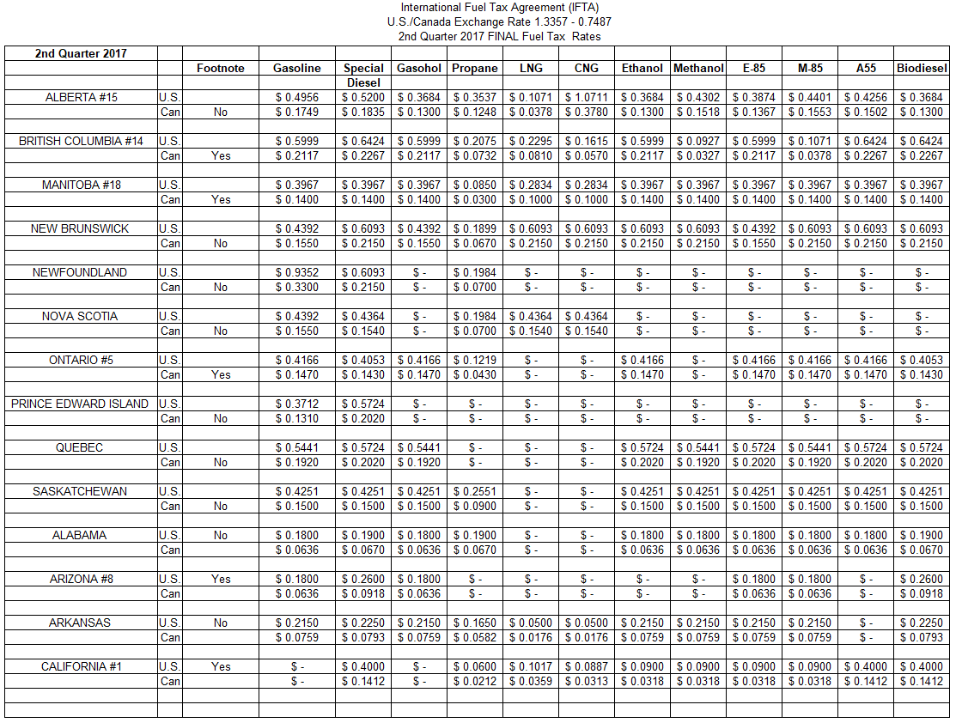

Slide 17
Tom Asks
Is this what you are looking for?
How many jurisdictions would use this?
Should we just create a new download type with this information so that those that would use the footnote information?

Slide 18
IFTA TEMPORARIES
How many jurisdictions allow IFTA temporaries to new accounts? We make them wait a year.

Slide 19
Processing Systems
As many of you know, Conduent has announced to its jurisdiction that it will not be renewing IFTA processing contracts.
How will this affect the IFTA community if some jurisdictions cannot get up and running prior to the release date?

Slide 20
Licensee Seminars
We are on the edge of possibly establishing licensee seminars to provide education and information to our carriers through an information night, afternoon, or other.
No details have been defined as yet so we would be delighted to learn from our counterparts – best practices, hits or misses, etc.

Slide 21
Navigating the Future
What is the future of IFTA?
In light of the many advancements in technology for qualified motor vehicles, will fuel tax returns even be necessary?
If not, what will replace it?
What is the future of the organizations (IFTA, IRP, UCR) as leadership changes loom?
Will we have eCredentials?

